Slide 1


Slide 2

INTRODUCTION
Battery is the most essential component of any vehicle. So perfect maintenance of any battery is very much essential for it to function properly.
Lead Acid batteries which are more commonly used in the vehicular batteries, need to be efficiently monitored, for it to perform better under all circumstances.

Slide 3
LITERATURE SURVEY
We have Examined that current Battery Management System Architecture developed doesn’t have a mobile App system.
It doesn’t give information to the user about battery status and its internal parameters.
Our Project differs from the existing BMS in showing the battery parameters through various interfaces like Mobile App , Website.
And the existing Battery Management System developed is based on Electric Vehicles only & not working model on Normal Automobiles.

Slide 4
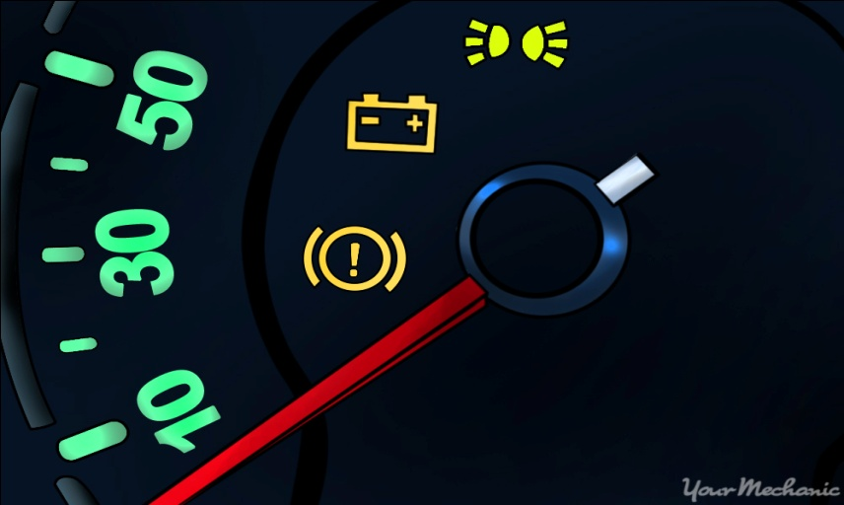
EXISTING SYSTEM
The traditional BMS which is present in automobile displays , the battery status in the form of icon without showing its internal parameters,when user tries to start or run the vehicle it indicates through led battery symbol only.

Slide 5



PROPOSED SYSTEM
Based on the problems in the traditional battery management system , we proposed a battery monitoring system through which user can interactively monitor the battery .Based on the internal parameter like State of Charge (SoC) using a mobile app and website through IOT technology.

Slide 6
REQUIREMENTS
Software:
Sublime Text 3.
Arduino Ide.
Android studio.
Hardware:
Arduino UNO board.
Bluetooth module.
Temperature sensor.
Wifi Module.
9v Battery(lead-acid).
Power supply Adapter.

Slide 7






MODULES
Bluetooth Connect : In this the user connects to the IOT device using the bluetooth from his mobile to monitor the battery.
Temperature : Here the user can see the temperature readings from IoT device.
Percentage : It displays the battery percentage based on its usage by the user.
Voltage : Here the Voltage refers the battery potentials which will be based on the battery percentage and its charging.
Charging / Discharging Status : It display the battery charging / Discharging status when the user connects it for charging.

Slide 8
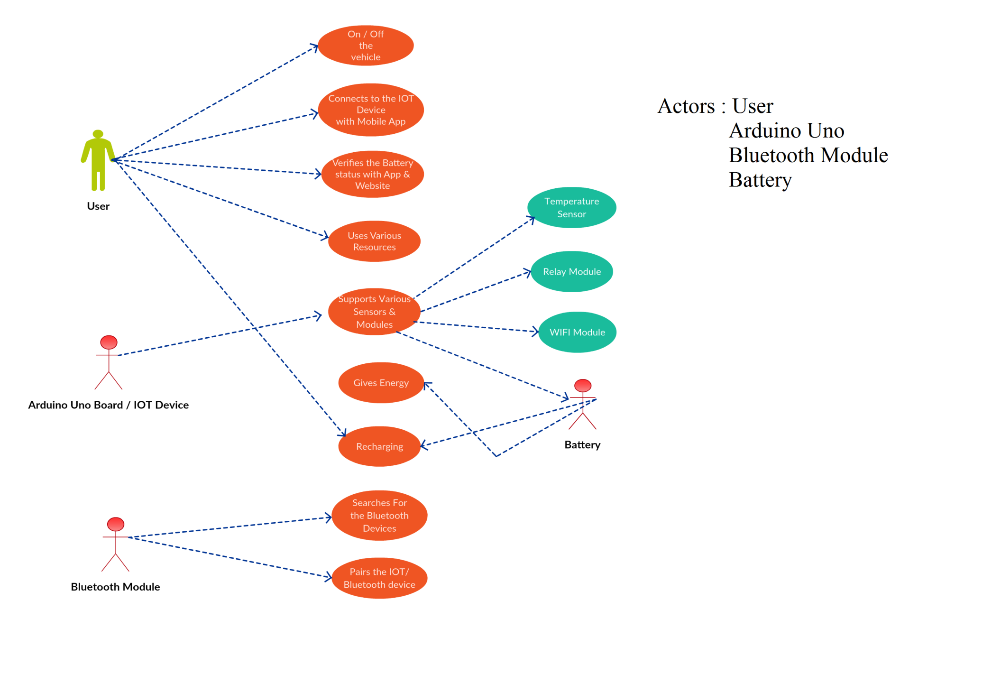
UML USECASE DIAGRAM

Slide 9
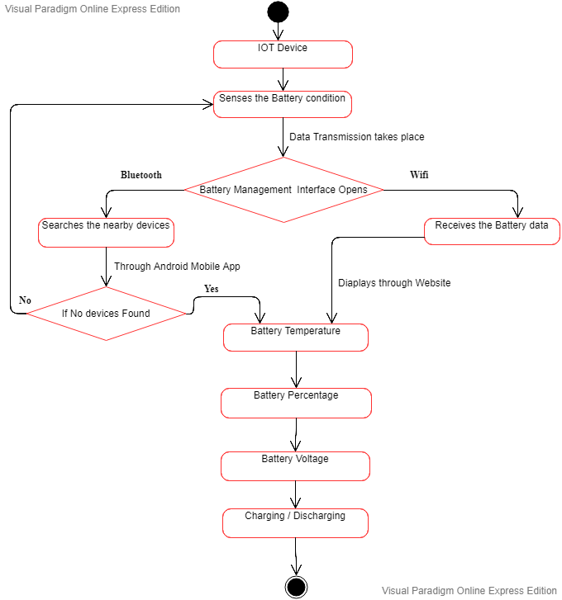
UML STATECHART DIAGRAM

Slide 10
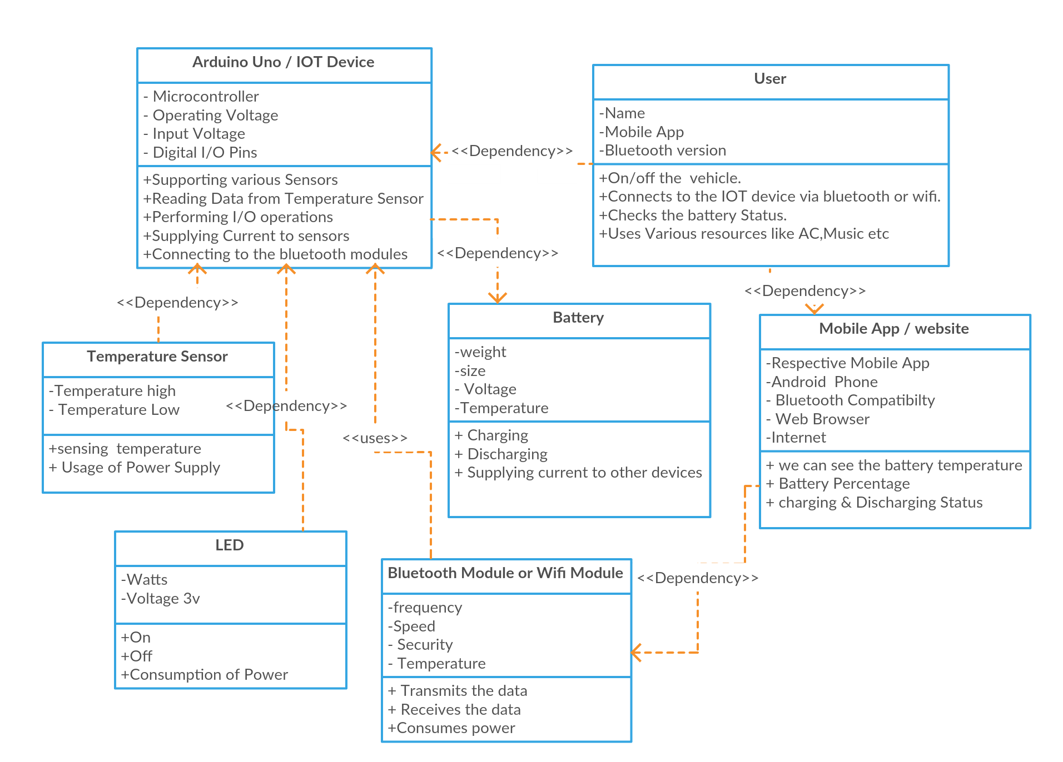
UML CLASS DIAGRAM

Slide 11







DEVELOPMENT
FRONT-END
BACKEND

Slide 12
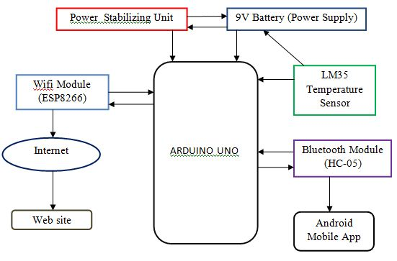
BLOCK DIAGRAM

Slide 13
ADVANTAGES
DISADVANTAGES
Our system makes easy Monitoring.
Less Cost regarding battery.
High efficiency in sensing the battery.
Gives the User Interface through various platforms.
Corrosion can cause damage to the positive and negative terminals of battery.
Short Circuit may occur in IOT device.
User should be aware of using internet and smart phone.

Slide 14
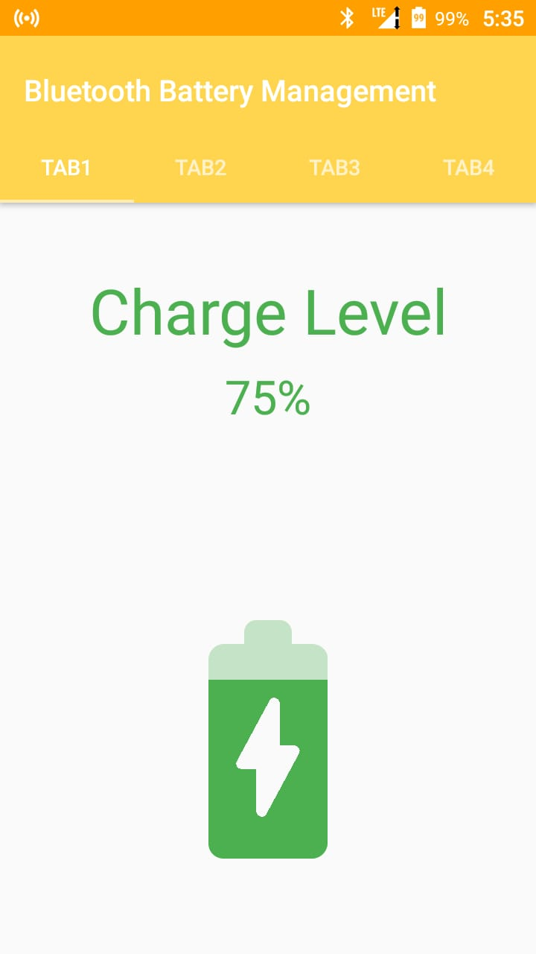
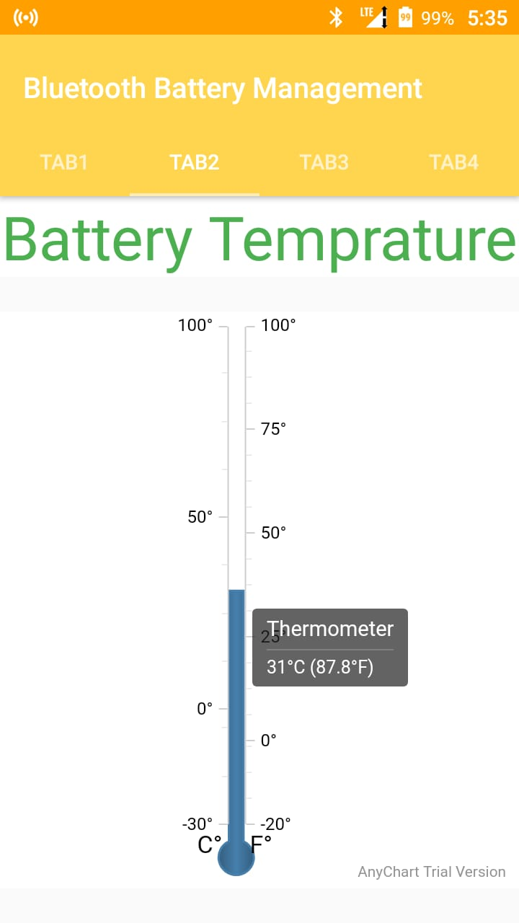
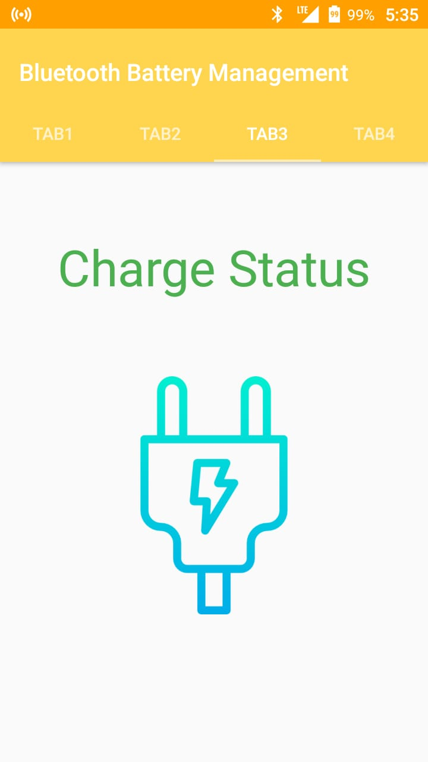
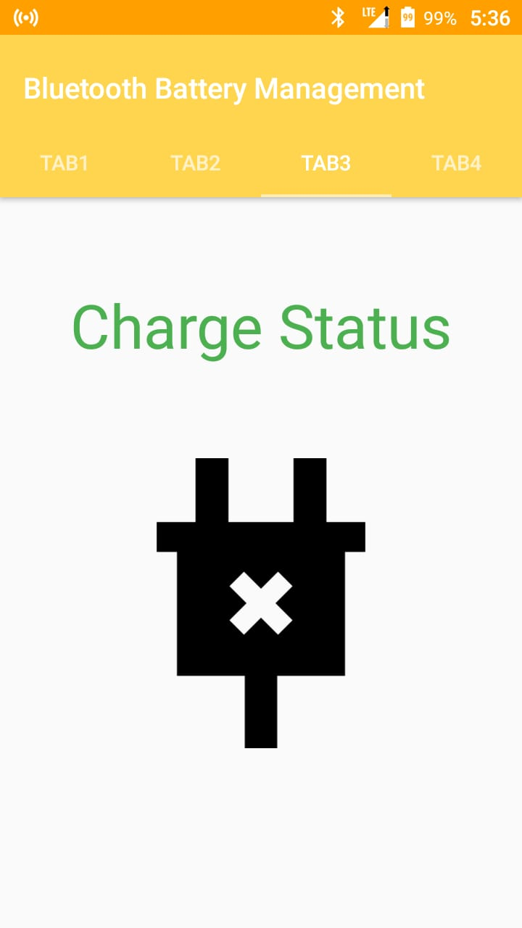
SCREENSHOTS
MOBILE APP
Percentage
Temperature
Charging / discharging Status

Slide 15
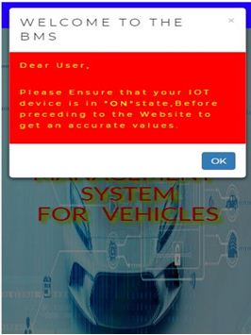
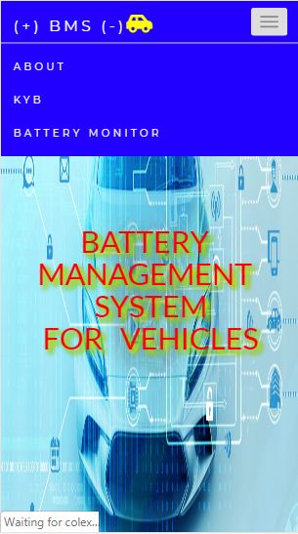
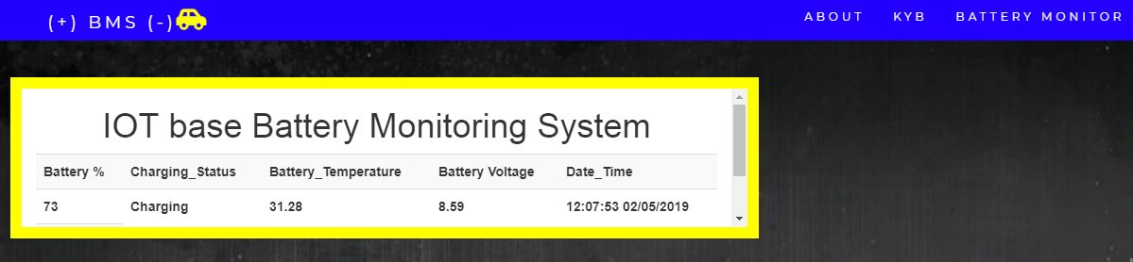
WEBSITE
Home Page
Services
Battery Monitoring System

Slide 16
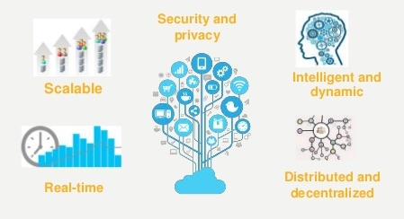
FUTURE ENHANCEMNT
Our Battery management system which was developed is a basic model, which can be suitable to work in any vehicle like electric vehicles and non electric vehicle also but it only monitors the battery. So taking our project to next level is deploying it in cloud.

Slide 17


